Slide 1

Chapter 19
Network Layer:
Logical Addressing
19.<number>

Slide 2
IP Addresses
An IPv4 address is a 32-bit address that uniquely and universally defines the connection of a device(for example, a computer or a router) to the Internet.
An IP address does not actually refer to a host.
It refers to a network interface, so if a host is on two networks, it must have two IP addresses.
However, in practice, most hosts are on one network and thus have one IP address.
In contrast, routers have multiple interfaces and thus multiple IP addresses.
19.<number>

Slide 3
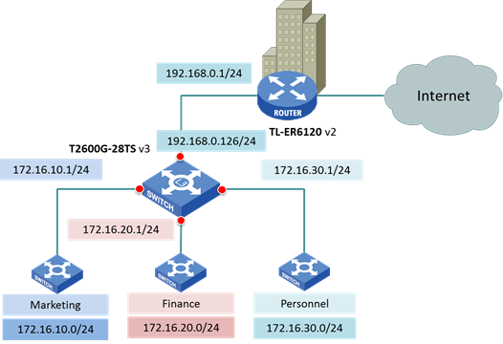
19.<number>

Slide 4

An IPv4 address is 32 bits long.
binary notation
Dotted-decimal notation
The address space of IPv4 is
2³² or 4,294,967,296.
The IPv4 addresses are unique
and universal.
19.<number>

Slide 5
Example 19.1
Change the following IPv4 addresses from binary notation to dotted-decimal notation.
10000001 00001011 00001011 11101111
11000001 10000011 00011011 11111111
Solution
We replace each group of 8 bits with its equivalent decimal number and add dots for separation.
129.11.11.239
193.131.27.255
19.<number>

Slide 6
Example 19.2
Change the following IPv4 addresses from dotted-decimal notation to binary notation.
111.56.45.78
221.34.7.82
Solution
We replace each decimal number with its binary equivalent.
01101111 00111000 00101101 01001110
11011101 00100010 00000111 01010010
19.<number>

Slide 7
Example 19.3
Find the error, if any, in the following IPv4 addresses.
111.56.045.78
221.34.7.8.20
75.45.301.14
11100010.23.14.67
Solution
a. There must be no leading zero (045).
b. There can be no more than four numbers.
c. Each number needs to be less than or equal to 255.
d. A mixture of binary notation and dotted-decimal
notation is not allowed.
19.<number>

Slide 8
Addressing
There are 2 types of addressing in IPv4:
Classful Addressing
  Address space is divided into five classes-
    A, B, C, D, and E.
Classless Addressing
19.<number>

Slide 9

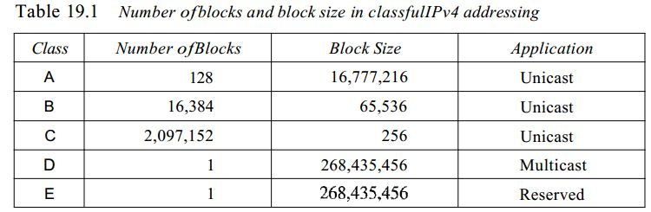
Figure 19.2 Finding the classes in binary and dotted-decimal notation
2⁸⁻¹=
2²⁴=
2¹⁶⁻²=
2¹⁶=
2²⁴⁻³=
2⁸=
2²⁸=
2²⁸=
19.<number>

Slide 10
Example 19.4
Find the class of each address.
a. 00000001 00001011 00001011 11101111
b. 11000001 10000011 00011011 11111111
c. 14.23.120.8
d. 252.5.15.111
Solution
a. The first bit is 0. This is a class A address.
b. The first 2 bits are 1; the third bit is 0. This is a class C
address.
c. The first byte is 14; the class is A.
d. The first byte is 252; the class is E.
19.<number>

Slide 11

Net id and host id
An IP address has 2 parts- netid and hostid
Netid identifies the network or represents the block number
Host id identifies the connection of the host
Two levels of hierarchy in an IPv4 address with no subnetting
19.<number>

Slide 12
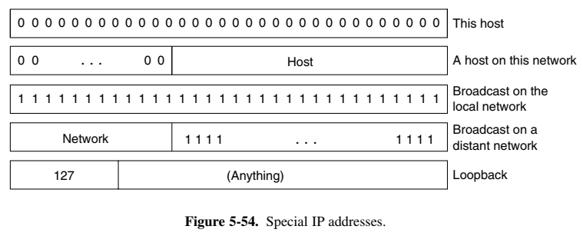
19.<number>

Slide 13
Find the netid and the hostid of the following IP addresses :
128.125.31.56
19.34.21.5
157.37.64.87
220.34.8.9
190.35.64.89
10.10.5.9
19.<number>

Slide 14
Binary Number System
00 00 00 00
00 00 00 01
00 00 00 10
00 00 00 11
00 00 01 00
00 00 01 01
00 00 01 10
00 00 01 11
00 00 10 00
00 00 10 01
00 00 10 10
00 00 10 11
00 00 11 00
00 00 11 01
00 00 11 10
00 00 11 11
00 01 00 00
00 01 00 01
00 01 00 10
00 01 00 11
00 01 01 00
00 01 01 01
00 01 01 10
00 01 01 11
00 01 10 00
00 01 10 01
00 01 10 10
00 01 10 11
00 01 11 00
00 01 11 01
00 01 11 10
00 01 11 11
00 10 00 00
00 10 00 01
00 10 00 10
00 10 00 11
00 10 01 00
00 10 01 01
00 10 01 10
00 10 01 11
00 10 10 00
00 10 10 01
00 10 10 10
00 10 10 11
00 10 11 00
00 10 11 01
00 10 11 10
00 10 11 11
00 11 00 00
00 11 00 01
00 11 00 10
00 11 00 11
00 11 01 00
00 11 01 01
00 11 01 10
00 11 01 11
00 11 10 00
00 11 10 01
00 11 10 10
00 11 10 11
00 11 11 00
00 11 11 01
00 11 11 10
00 11 11 11
19.<number>

Slide 15
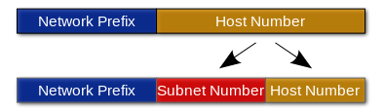
Subnets and Supernets
Subnet: breaking up a large network into smaller ones (increasing the subnet mask value)
Supernet: merging smaller networks into one big network (decreasing the subnet mask value)
19.<number>

Slide 16
Mask
A subnet mask hides, or "masks," the network part of a system's IP address and leaves only the host part as the machine identifier.
Table 19.2 Default masks for classful addressing
Class | Binary | Dotted-Decimal | CIDR
A | 11111111 00000000 00000000 00000000 | 255.0.0.0 | /8
B | 11111111 11111111 00000000 00000000 | 255.255.0.0 | /16
C | 11111111 11111111 11111111 00000000 | 255.255.255.0 | /24
Masks help in finding the netid and hostid.
19.<number>

Slide 17
Subnet Mask
A common subnet mask for a Class C IP address is 255.255.255.0.
Each section of the subnet mask can contain a number from 0 to 255, just like an IP address.
Therefore, in the example above, the first three sections are full, meaning the IP addresses of computers within the subnet mask must be identical in the first three sections.
The last section of each computer's IP address can be anything from 0 to 255.
19.<number>

Slide 18
Subnet Mask
For example, the IP addresses 192.0.1.201 and 192.0.1.202 would be in the same subnet, while 192.0.2.201 would not.
Therefore, a subnet mask of 255.255.255.0 allows for close to 256 unique hosts within the network (since not all 256 IP addresses can be used).
19.<number>

Slide 19
Binary Number System
For example, consider for an ip address of class A say x.y.z.t, where x,y,z and t all have 2 bits only
00 00 00 00
00 00 00 01
00 00 00 10
00 00 00 11
00 00 01 00
00 00 01 01
00 00 01 10
00 00 01 11
00 00 10 00
00 00 10 01
00 00 10 10
00 00 10 11
00 00 11 00
00 00 11 01
00 00 11 10
00 00 11 11
00 01 00 00
00 01 00 01
00 01 00 10
00 01 00 11
00 01 01 00
00 01 01 01
00 01 01 10
00 01 01 11
00 01 10 00
00 01 10 01
00 01 10 10
00 01 10 11
00 01 11 00
00 01 11 01
00 01 11 10
00 01 11 11
00 10 00 00
00 10 00 01
00 10 00 10
00 10 00 11
00 10 01 00
00 10 01 01
00 10 01 10
00 10 01 11
00 10 10 00
00 10 10 01
00 10 10 10
00 10 10 11
00 10 11 00
00 10 11 01
00 10 11 10
00 10 11 11
00 11 00 00
00 11 00 01
00 11 00 10
00 11 00 11
00 11 01 00
00 11 01 01
00 11 01 10
00 11 01 11
00 11 10 00
00 11 10 01
00 11 10 10
00 11 10 11
00 11 11 00
00 11 11 01
00 11 11 10
00 11 11 11
19.<number>

Slide 20
Why do we need to go for Classless Addressing?
2⁸⁻¹=
2²⁴=
2¹⁶⁻²=
2¹⁶=
2²⁴⁻³=
2⁸=
2²⁸=
2²⁸=
In classful addressing, a large part of the available addresses were wasted because addresses were assigned to organizations in blocks and not all addresses were required hence not used/wasted.
Classful addressing, which is almost obsolete, is replaced with classless addressing.
19.<number>

Slide 21
Classless Addressing
Restrictions:
  Address in a block must be contiguous
  Number of addresses in a block must be power of 2
  First address must be evenly divisible by the number of addresses in the block.
19.<number>

Slide 22

Example 19.5
Figure 19.3 shows a block of addresses, in both binary and dotted-decimal notation, granted to a small business that needs 16 addresses.
The number of addresses is a power of 2 (16 = 2⁴), and
the first address is divisible by 16.
The first address, when converted to a decimal number, is 3,440,387,360, which when divided by 16 results in 215,024,210.
19.<number>

Slide 23

Note
In IPv4 addressing, a block of
addresses can be defined as
x.y.z.t /n
in which x.y.z.t defines one of the addresses and the /n defines the mask.
A Mask /n implies that the leftmost n bits
are 1 while rest 32-n rightmost bits are 0.
19.<number>

Slide 24
Problem Type 1:
If any 1 IP address from the block is provided along with the mask of the block, say x.y.z.t/n, how can we identify the first address, last address and total number of IP addresses in a block of IP addresses?
  Setting the rightmost bits
  ANDing and ORing
You can opt for any method but don’t mix up the 2 methods...
19.<number>

Slide 25
A block of addresses is granted to a small organization. We know that one of the addresses is 205.16.37.39/28. What is the first address, last address and the total no. of IP addresses in the block?
Method-I
19.<number>

Slide 26
The first address in the block can be found by setting the rightmost 32 − n bits to 0s.
A block of addresses is granted to a small organization. We know that one of the addresses is 205.16.37.39/28. What is the first address in the block?
Solution
The binary representation of the given address is
11001101 00010000 00100101 00100111
If we set 32−28 rightmost bits to 0, we get
11001101 00010000 00100101 0010000
Or 205.16.37.32.
19.<number>

Slide 27
The last address in the block can be found by setting the rightmost 32 − n bits to 1s.
The binary representation of the given address is
11001101 00010000 00100101 00100111
If we set 32 − 28 rightmost bits to 1, we get
11001101 00010000 00100101 00101111
or
205.16.37.47
This is actually the block shown in Figure 19.3.
19.<number>

Slide 28
The number of addresses in the block can be found by using the formula
2^{32−n}.
The value of n is 28, which means that number
of addresses is 2 ³²⁻²⁸ or 16.
19.<number>

Slide 29
A block of addresses is granted to a small organization. We know that one of the addresses is 205.16.37.39/27. What is the first address, last address and total number of IP addresses in the block?
Method-I
19.<number>

Slide 30
A block of addresses is granted to a small organization. We know that one of the addresses is 205.16.37.39/27. What is the first address, last address and total number of IP addresses in the block?
The binary representation of the given address is
  11001101 00010000 00100101 00100111
If we set 32 − 27 rightmost bits to 0, we get the first addr.
  11001101 00010000 00100101 00100000
  Or, 205. 16. 37. 32
If we set 32 − 27 rightmost bits to 1, we get the last addr.
  11001101 00010000 00100101 00111111
  Or, 205. 16. 37. 63
Total number of IP addresses in the block is 2⁽³²⁻²⁷⁾=2⁵=32
19.<number>

Slide 31
A block of addresses is granted to a small organization. We know that one of the addresses is 205.16.37.39/29. What is the first address, last address and total number of IP addresses in the block?
Method-I
19.<number>

Slide 32
A block of addresses is granted to a small organization. We know that one of the addresses is 205.16.37.39/29. What is the first address, last address and total number of IP addresses in the block?
The binary representation of the given address is
  11001101 00010000 00100101 00100111
If we set 32 − 29 rightmost bits to 0, we get the first addr.
  11001101 00010000 00100101 00100000
  Or, 205. 16. 37. 32
If we set 32 − 29 rightmost bits to 1, we get the last addr.
  11001101 00010000 00100101 00100111
  Or, 205. 16. 37. 39
Total number of IP addresses in the block is 2⁽³²⁻²⁹⁾=2³=8
19.<number>

Slide 33
To be contd..
19.<number>

Slide 34
A block of addresses is granted to a small organization. We know that one of the addresses is 205.16.37.39/28. What is the first address, last address and the total no. of IP addresses in the block?
Method-II
19.<number>

Slide 35
Example 19.9
Another way to find the first address, the last address, and the number of addresses is to represent the mask as a 32-bit binary number. This is particularly useful when we are writing a program to find these pieces of information. In Example 19.5 the /28 can be represented as
11111111 11111111 11111111 11110000
(twenty-eight 1s and four 0s).
Find
a. The first address
b. The last address
c. The number of addresses.
19.<number>

Slide 36

Example 19.9 (continued)
The first address can be found by bit by
bit ANDing the given addresses with the mask.
205.16.37.39 => 11001101 00010000 00100101 00100111
AND
205.16.37.32
19.<number>

Slide 37

Example 19.9 (continued)
The last address can be found by bitwise ORing the given addresses with the complement of the mask.
205.16.37.39 => 11001101 00010000 00100101 00100111
OR
205.16.37.47
19.<number>

Slide 38
Example 19.9 (continued)
The number of addresses can be found by
complementing the mask, interpreting it as a decimal
number, and adding 1 to it.
19.<number>

Slide 39
A block of addresses is granted to a small organization. We know that one of the addresses is 205.16.37.39/27. What is the first address, last address and total number of IP addresses in the block?
Method-II
19.<number>

Slide 40
First address:
  205.16.37.39 => 11001101 00010000 00100101 00100111
  Mask is 27=> 11111111 11111111 11111111 11100000
  Bitwise AND=> 11001101 00010000 00100101 00100000
  Resulting value: 205.16.37.32
Last Address:
  205.16.37.39 => 11001101 00010000 00100101 00100111
  Mask Compliment=>00000000 00000000 00000000 00011111
  Bitwise OR=> 11001101 00010000 00100101 00111111
  Resulting value: 205.16.37.63
Total No. of Addresses:
  Mask Compliment=>00000000 00000000 00000000 00011111
  Decimal Value of Mask Compliment: 31
  No. of addresses = 31+1 = 32.
19.<number>

Slide 41
A block of addresses is granted to a small organization. We know that one of the addresses is 205.16.37.39/29. What is the first address, last address and total number of IP addresses in the block?
Method-II
19.<number>

Slide 42
First address:
  205.16.37.39 => 11001101 00010000 00100101 00100111
  Mask is 29=> 11111111 11111111 11111111 11111000
  Bitwise AND=> 11001101 00010000 00100101 00100000
  Resulting value: 205.16.37.32
Last Address:
  205.16.37.39 => 11001101 00010000 00100101 00100111
  Mask Compliment=>00000000 00000000 00000000 00000111
  Bitwise OR=> 11001101 00010000 00100101 00100111
  Resulting value: 205.16.37.39
Total No. of Addresses:
  Mask Compliment=>00000000 00000000 00000000 00000111
  Decimal Value of Mask Compliment: 7
  No. of addresses = 7+1 = 8.
19.<number>

Slide 43
Note
The first address in a block is
normally not assigned to any device;
it is used as the network address that represents the organization
to the rest of the world.
19.<number>

Slide 44
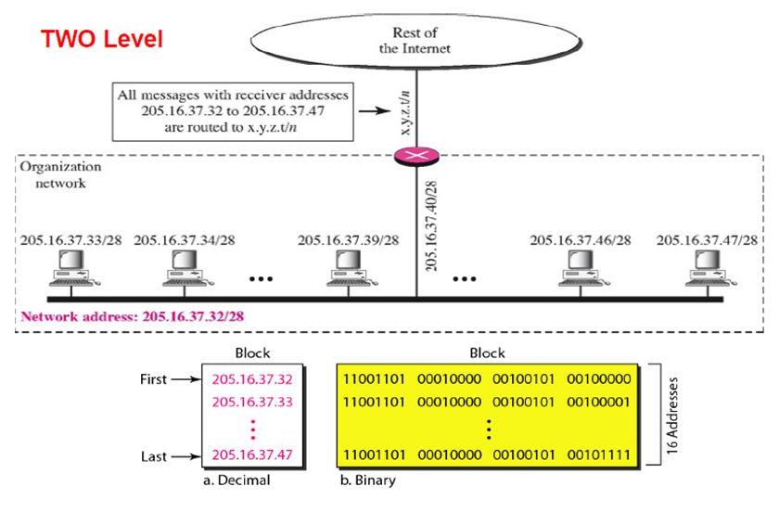
Figure 19.4 A network configuration for the block 205.16.37.32/28
205.16.37.32
19.<number>

Slide 45
Problem Type 2
Suppose an organization is given the block 17.12.40.0/26, which contains 64 addresses. The organization has 3 offices and needs to divide the addresses into 3 sub-blocks of 32, 16, and 16 addresses.
Log₂32 = 5 => 5bits will be required for the host address. That leaves a subnet mask of 32-5 = 27.
Log₂16 = 4 => subnet mask of 32-4 = 28.
Now that we know the subnet masks, can you find the starting and ending address of all 3 sub-blocks?
19.<number>

Slide 46
In this case, the 1st sub-block requires 32 addresses while the 2nd and 3rd sub-blocks require only 16 addresses.
Considering the 1st sub-block:
  Mask = 27. This means, only the last octet is going to get changed, the 1st 3 octets remain as it is.
  Last octet is 0, i.e., 00000000.
  Now, the first address sets the rightmost 32-n bits to 0. Thus, the last octet of the 1st address of the sub-block remains 0.
  The last address sets the rightmost 32-n bits to 1 (n=27). Thus, the last octet of the last address of the sub-block becomes 00011111, i.e. 31.
  So, the range of the address of the 1st sub-block is 17.12.40.0/27-17.12.40.31/27
19.<number>

Slide 47
Considering the 2nd sub-block:
  Mask = 28. This means, only the last octet is going to get changed, the 1st 3 octets remain as it is.
  Now, addresses up to 31 has been assigned to the 1st sub-block, so this sub-block should start from 32.
  So considering the last octet as 32, i.e., 00100000.
  Now, the 1st address sets the rightmost 32-n bits to 0 (n=28). Thus, the last octet of the 1st address of the sub-block remains 32 because its last 4 bits remain 0.
  The last address sets the rightmost 32-n bits to 1. Thus, the last octet of the last address of the sub-block becomes 00101111, i.e. 47.
  So, the range of the address of the 2nd sub-block is 17.12.40.32/28-17.12.40.47/28.
19.<number>

Slide 48
Considering the 3rd sub-block:
  Mask = 28. This means, only the last octet is going to get changed, the 1st 3 octets remain as it is.
  Now, addresses up to 47 has been assigned, so this sub-block should start from 48.
  So consider the last octet is 48, i.e., 00110000.
  Now, the first address sets the rightmost 32-n bits to 0 (n=28). Thus, the last octet of the 1st address of the sub-block remains 48 because its last 4 bits remain 0.
  The last address sets the rightmost 32-n bits to 1. Thus, the last octet of the last address of the sub-block becomes 00111111, i.e. 63.
  So, the range of the address of the 3rd sub-block is 17.12.40.48/28-17.12.40.63/28.
19.<number>

Slide 49

Figure 19.8 Three-level hierarchy in an IPv4 address
19.<number>

Slide 50

Figure 19.7 Configuration and addresses in a subnetted network
19.<number>

Slide 51
Problem Type 3
An ISP is granted a block of addresses starting with 190.100.0.0/16 (65,536 addresses). The ISP needs to distribute these addresses to three groups of customers as follows:
a. The first group has 64 customers; each needs 256
addresses.
b. The second group has 128 customers; each needs 128
addresses.
c. The third group has 128 customers; each needs 64
addresses.
Design the sub-blocks and find out how many addresses are still available after these allocations.
19.<number>

Slide 52
Example 19.10 (continued)
Group 1
For this group, each customer needs 256 addresses.
This means log₂256 i.e., 8 bits are needed to define each host.
The prefix length is thus 32 − 8 = 24.
So the rightmost 8 bits (last octet) are assigned for the host id.
8 bits => range 0 to 2⁸-1=>0-255, so last octet for each customer is from 0 – 255.
19.<number>

Slide 53
No. of customers = 64,
This means log₂64 = 6 bits are required to identify the sub-block of each customer.
This means the id for each customer =>range 0 to 2⁶-1 => 0 to 63 (111111).
Now, the host address takes the entire 4th octet and the customer id takes the 3rd octet.
19.<number>

Slide 54
Thus, the addresses are:
1st customer: 190.100.0.0/24 ---190.100.0.255/24
2nd customer: 190.100.1.0/24---190.100.1.255/24
.
.
.
64th customer: 190.100.63.0/24---190.100.63.255/24
Total = 64x256 = 16384.
19.<number>

Slide 55
Example 19.10 (continued)
Group 2
For this group, each customer needs 128 addresses.
This means log₂128 = 7 bits are needed to define each host.
The prefix length is thus 32 − 7 = 25.
Now, the last address of group 1 had the last octet as 255, i.e. 8 ones.
Adding 1 to it is going to reset it to 8 zeroes.
Thus, range of the hosts start from 8 zeroes but go up to 01111111 only because prefix is 25.
1
7
19.<number>

Slide 56
No. of customers = 128.
Thus, number of bits required to identify the sub-blocks of each customer = log₂128 = 7 bits. (green)
Now, in the 1st group, the highest value for the customer id is 63=>111111
So, in this group the customer address should start from 64, i.e., 01000000 (last 6 bits) and go upto 01111111(last 6 bits) =>127
2
6
19.<number>

Slide 57
The addresses are:
1st customer: 190.100.64.0/25---190.100.64.127/25
2nd customer: 190.100.64.128/25---190.100.64.255/25
…
128th customer: 190.100.127.128/25---190.100.127.255/25
Total = 128x128=16384
19.<number>

Slide 58
Group 3
For this group, each customer needs 64 addresses.
This means that 6 (log₂64) bits are needed to each host.
The prefix length is then 32 − 6 = 26.
For this group, each customer needs 128 addresses.
This means log₂128 = 7 bits are needed to define each host.
Value of last octet of last address of group II was 255.
So adding 1, it gets reset to 8 zeroes.
Thus, range of the hosts for 1st customer are 00000000 to 00111111= 0-63.
range of the hosts for 2nd customer is 64-127… and so on..
2
6
19.<number>

Slide 59
No. of customers = 128.
Thus, number of bits required to identify the sub-blocks of each customer = log₂128 = 7 bits.
Now, in the 2nd group, the highest value for the customer id is 127=>01111111(6bits)
So, in this group the customer address should start from 128, i.e., 10000000 (5bits)
And host address should start from 0.
So the highest id of the customer will be 10011111(5bits) =>159
3
5
19.<number>

Slide 60
The addresses are:
1st customer: 190.100.128.0/26---190.100.128.63/26
2nd customer: 190.100.128.64/26---190.100.128.127/26
…
128th customer: 190.100.159.192/26---190.100.159.255/26
Total: 128x64=8192
19.<number>

Slide 61

Figure 19.9 An example of address allocation and distribution by an ISP
Number of granted addresses to the ISP: 65,536
Number of allocated addresses by the ISP: 40,960
Number of available addresses: 24,576
19.<number>

Slide 62
Problem Type 4
An organization is granted the block 190.64.32.64/24. The organization needs to have four subnets. What are the subnet addresses and the range of addresses for each subnet?
Mask = 24, bits available for hosts = 32-24= 8.
Setting, the rightmost 8 bits to 0, we get the first address of the block: 190.64.32.0.
Now, to identify 4 subnets, we need 2 bits-00,01,10,11.
So, rest 8-2=6 bits are available for hosts.
Since, only the last octet is going to change, the range of IP addr. With subnet address is going to be
  190.64.32.0/26-190.64.32.63/26
  190.64.32.64/26-190.64.32.127/26
  190.64.32.128/26-190.64.32.191/26
  190.64.32.192/26-190.64.32.255/26
2
6
00
000000-111111
01
000000-111111
10
000000-111111
11
000000-111111
19.<number>

Slide 63
Network Address Translation
19.<number>

Slide 64

Table 19.3 Addresses for private networks
19.<number>

Slide 65

Figure 19.10 A NAT implementation
19.<number>

Slide 66

Figure 19.11 Addresses in a NAT
19.<number>

Slide 67

Figure 19.12 NAT address translation
19.<number>

Slide 68
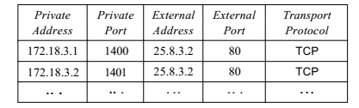
Table 19.4 Five-column translation table
19.<number>

Slide 69

Figure 19.13 An ISP and NAT
19.<number>

Slide 70
19-2 IPv6 ADDRESSES
Despite all short-term solutions, address depletion is still a long-term problem for the Internet. This and other problems in the IP protocol itself have been the motivation for IPv6.
Topics discussed in this section:
Structure
Address Space
19.<number>

Slide 71
Note
An IPv6 address is 128 bits long.
19.<number>

Slide 72

Figure 19.14 IPv6 address in binary and hexadecimal colon notation
19.<number>

Slide 73

Figure 19.15 Abbreviated IPv6 addresses
19.<number>

Slide 74

Example 19.11
Expand the address 0:15::1:12:1213 to its original.
Solution
We first need to align the left side of the double colon to the left of the original pattern and the right side of the double colon to the right of the original pattern to find how many 0s we need to replace the double colon.
This means that the original address is.
19.<number>

Slide 75

Table 19.5 Type prefixes for IPv6 addresses
19.<number>

Slide 76

Table 19.5 Type prefixes for IPv6 addresses (continued)
19.<number>

Slide 77

Figure 19.16 Prefixes for provider-based unicast address
19.<number>

Slide 78

Figure 19.17 Multicast address in IPv6
19.<number>

Slide 79

Figure 19.18 Reserved addresses in IPv6
19.<number>

Slide 80

Figure 19.19 Local addresses in IPv6
19.<number>

Slide 81
IPv6 Current Status (2020)
https://www.networkworld.com/article/3254575/what-is-ipv6-and-why-aren-t-we-there-yet.html
19.<number>

